Slide 1



Simplifying Data, Empowering Decisions
By Gatduel Riek
01

Slide 2

Where Does Your Data Really Come From?
Is Your Analysis Built on Reliable Data?
Where Are Businesses Getting Their Insights?
Organizations struggle to access clean, structured, and timely online data. Manual collection wastes resources, while poor data quality undermines analysis and decision‑making.
10

Slide 3

Web Scraping and automation tools
We use Python web scraping and script automation to collect millions of structured and clean data within 10 to 20 minutes
06

Slide 4
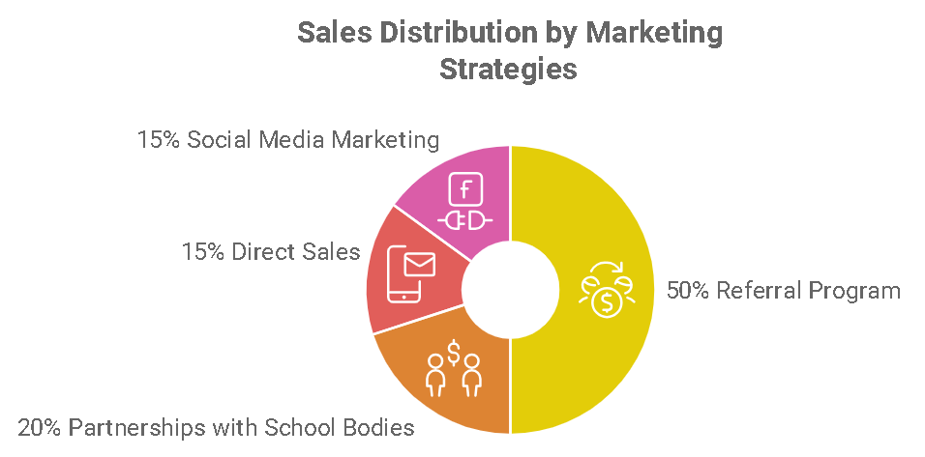
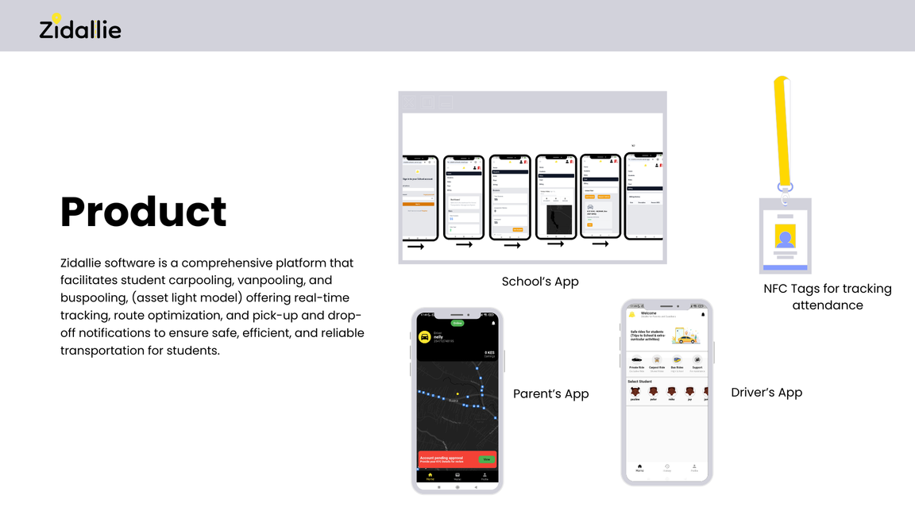
Data engineering
We send Python libraries to some website, it fetch unstructured raw html data, parse them using beautifulsoup and structures it and export them to different file format using Pandas, an alternative to requests and beautifulsoup is Selenium with combination to Pandas
04

Slide 5



Demand Landscape
5 OUT 10
Half of industries already invest in data-driven tools but lack scalable scraping solutions.
95%
95% of businesses believe real-time data is critical for competitive advantage.
123 million
123 million potential customers in industries like e-commerce, finance, and research need structured web data.
14

Slide 6
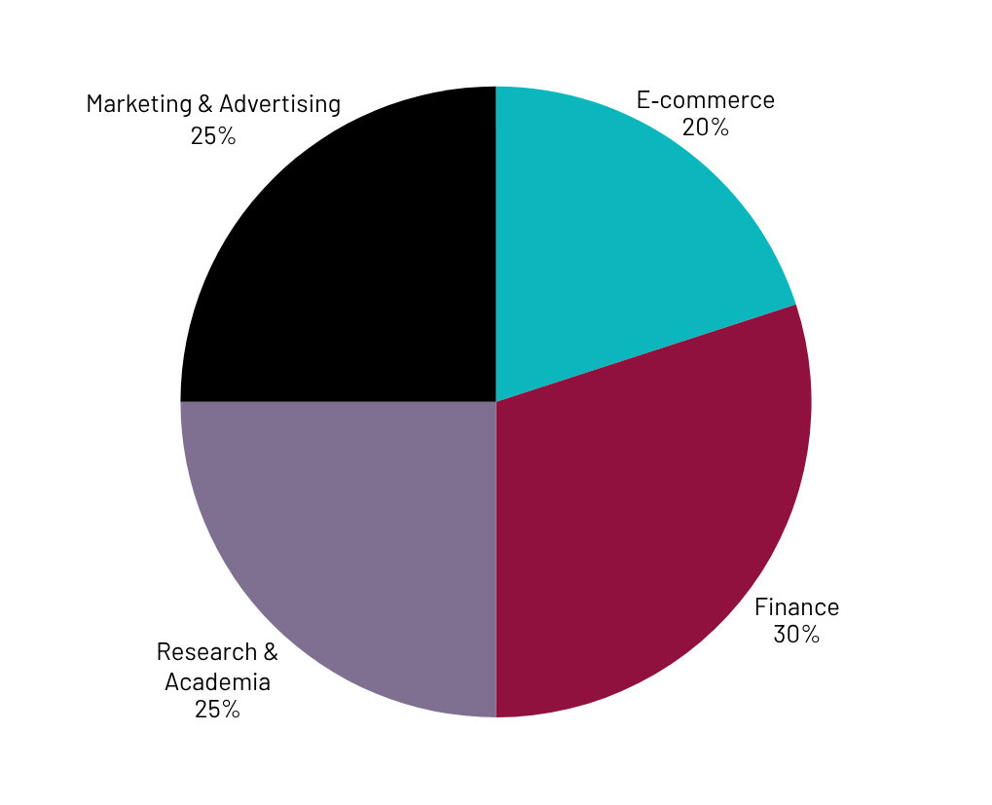
Market Size
  E‑commerce (20%) – Product pricing, competitor monitoring.
  Finance (20%) – Market trends, investment insights.
  Research & Academia (20%) – Data collection for studies.
  Marketing & Advertising (20%) – Consumer sentiment, campaign tracking

Slide 7

Competitors
  Bright Data – A global leader with massive proxy networks and pre-collected datasets, serving large enterprises.
  Zyte (Scrapinghub) – Compliance-focused scraping solutions with strong developer tools and cloud infrastructure.
  Apify – Marketplace of ready-made scrapers (“Actors”), popular with startups and automation developers.
  Oxylabs – Enterprise-scale proxy and scraping services, widely used in e-commerce and finance.
23

Slide 8

Competitive Advantage
  Affordable Pricing – I can serve SMEs, NGOs, and startups that big players often overlook because their services are too expensive.
  Customized Solutions – Instead of generic scraping tools, I can build tailored pipelines for specific industries like e‑commerce, research, or local markets.
  Local Market Focus – I can specialize in regions and sectors (like African markets) that global competitors don’t prioritize.
  Ease of Use – Offering simple dashboards or integrations makes my tools accessible even to non‑technical users.
  Ethical & Compliant Practices – By emphasizing transparency and lawful scraping, I build trust in a space where regulations are tightening.

Slide 9
Project Traction
Tasks
Month 1
Month 2
Month 3
Month 4
Month 5
Learn basic and Python foundation
Intermediate Python
Learning Python libraries for data engineer
Start practice webscraping
Specialization phase
23

Slide 10

  Starter Plan – $49/month for small SMEs needing basic scraping (limited pages, simple datasets).
  Growth Plan – $149/month for mid‑sized businesses with higher volume needs and API access.
  Enterprise Plan – $499/month for large clients requiring custom pipelines, dashboards, and priority support.
Business Model
23

Slide 11
Go To Market
I will reach my customers through:
  Direct Outreach via LinkedIn & Email Target SME owners and managers in e‑commerce, research, and local markets with tailored demos.
  Partnerships with Local Business Hubs/Incubators Collaborate with entrepreneurship centers, NGOs, and training programs to onboard SMEs who need affordable data solutions.

Slide 12
Social Impact
By automating access to online data, web scraping empowers NGOs, researchers, and small businesses with insights they couldn’t afford otherwise—driving transparency, education, and fair opportunity.

Slide 13
Our Ask
  We are raising $50,000 to scale our web scraping platform.
  Funds will be used for infrastructure (40%), product development (30%), and marketing (30%).

Slide 14



Thank you!
Email me at: gatduelriek@gmail.com or visit my LinkedIn account here:
www.linkedin.com/in/gatduel-riek-752086325
17

